Slide 1
SOCIAL BARRIERS (INDIA)
Presentation By:-
1. Shivashish Prasad
2. Aman Garg
3. Ashish Kumar
4. Ajinkya Bedekar
5. Javid Akhtar
6. Muskan Gupta

Slide 2
VARIOUS QUESTIONS………….
What are the social barriers?
How a social barriers is formed?
Language difference.
Stereotypes.
Difference of opinion.
Different lifestyle.
People who are affected due to social barriers?
Students.
Working class.
What are the negative effects and the intensity of it?
What are the solutions to Social Barriers?

Slide 3

WHAT ARE THE SOCIAL BARRIERS?
Social barriers are barriers to entry which are created by the culture of the community, i.e. people's behaviour towards newcomers or others in general.
Social barriers are things that people create as they find it difficult to relate to another type of person. They don 't really exist but are just reserves people have about other people therefore they have little or nothing to do with them.

Slide 4
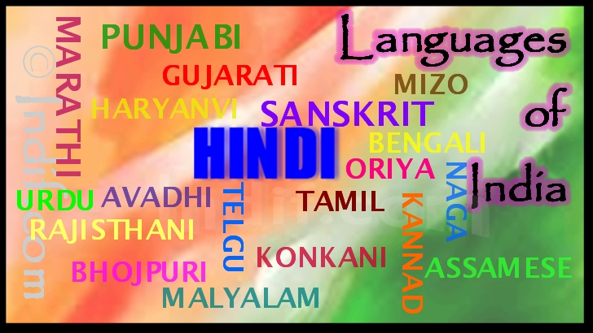
HOW ARE THE SOCIAL BARRIERS FORMED?
Language difference
India doesn’t have a national language but 22 official languages.
More than 150 languages have sizable speaking population.

Slide 5
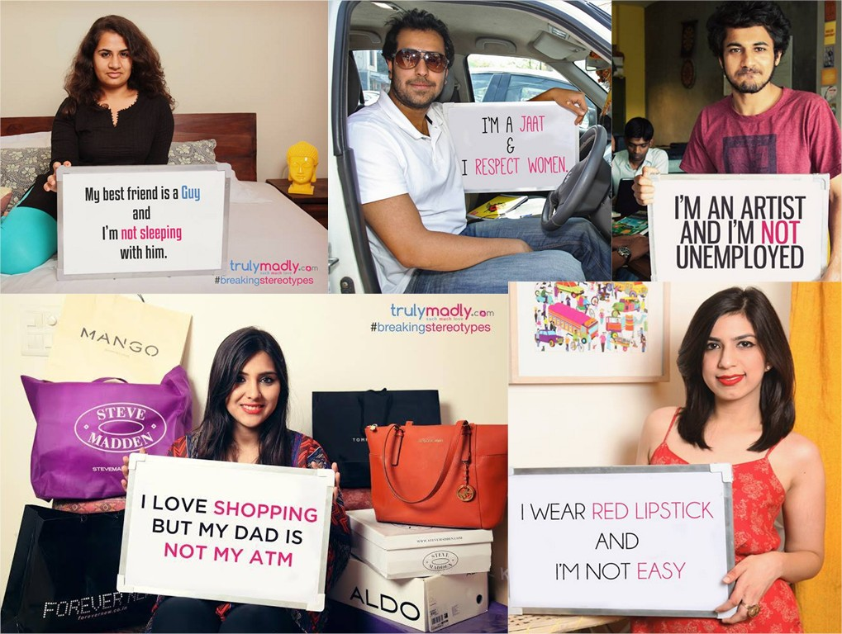
2. Stereotypes
Social Stereotyping is the process of ascribing particular behavioral or attitudinal traits (although it can often also include physical traits) to individuals on the basis of their apparent connection to, or membership of a group or class.

Slide 6
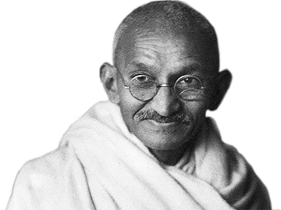
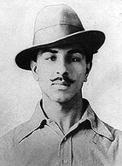
3. Difference of opinion
When a clash of opinions arise between two different societies, a social barrier is bound to occur.

Slide 7
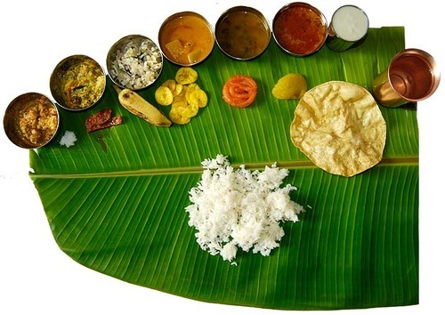

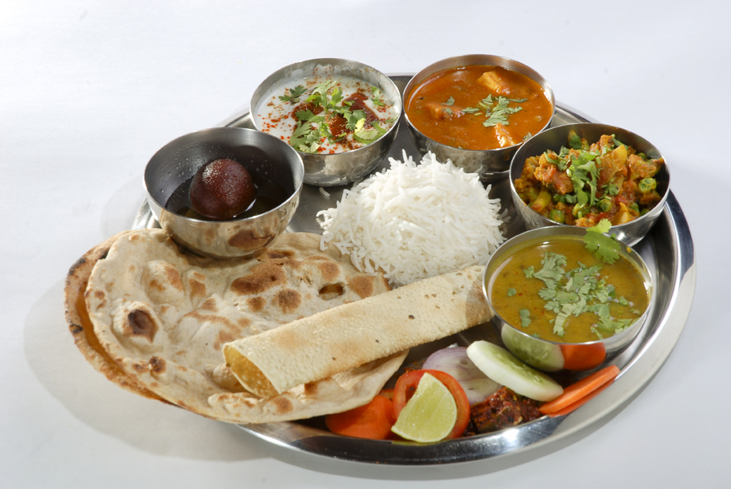
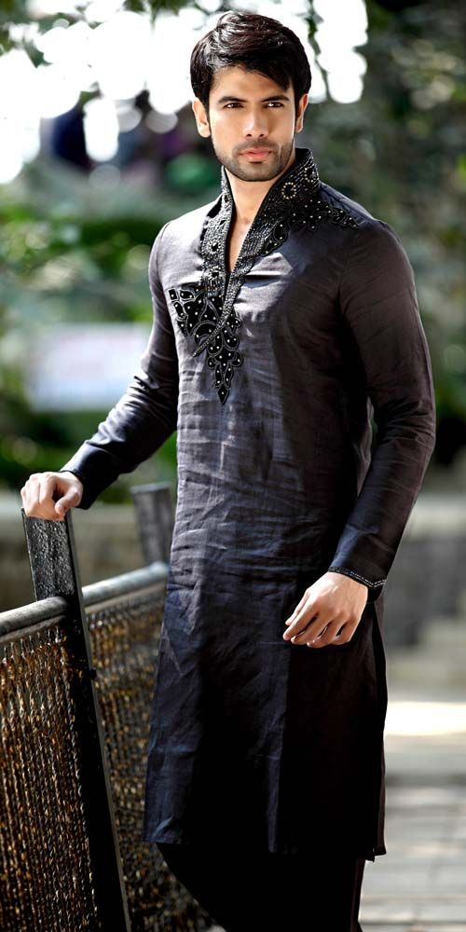
4. Different lifestyle
In southern India the food is entirely different to what is served in north India.
The dress code way of speaking, way of greeting and even way of working is different in all parts of India giving rise to groupism – Again giving rise to social barriers.

Slide 8
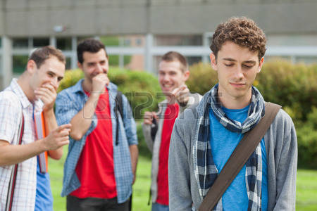
PEOPLE AFFECTED DUE TO SOCIAL BARRIER
Students
When a student goes to other place to pursue his education which has different cultures and traditions from the place where he belongs to, he would not be able to comply with the other community.
Problems faced:
Finding himself in an entirely alien surroundings created by social barrier it reduces the morale and the enthusiasm of the student.
This barrier creates groupism which restricts the growth of that student.
This some times even lead to violence.

Slide 9

2. Working class
Reservation in jobs – People have a biased opinion about the ones who get reservation.
Again if a person from one community enters a workplace in another state or city faces discrimination.
Your academic qualification and positon in company.

Slide 10
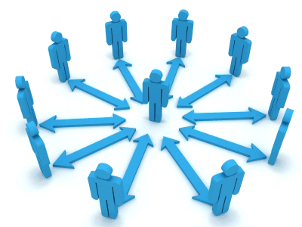
NEGATIVE EFFECTS AND INTENSITY OF SOCIAL BARRIERS
Reduced performance in workplace college and everywhere else.
It hampers the unity of the people making it more vulnerable to an attack.
Sometimes even results in violence.

Slide 11
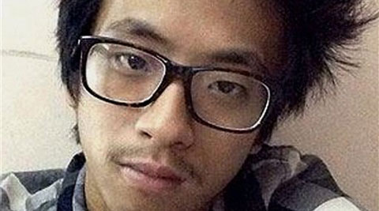
Violence
A teenage student from Arunachal Pradesh died in the city on Thursday, on the morning after he was beaten by a group of men led by the owner of a paneer shop in south Delhi’s Lajpat Nagar market.
-29th January 2014

Slide 12
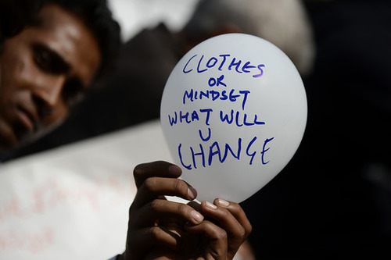
SOLUTIONS TO SOCIAL BARRIERS
Change your mentality
Stop blindly following stereotypes.
Start respecting the different cultures.

Slide 13
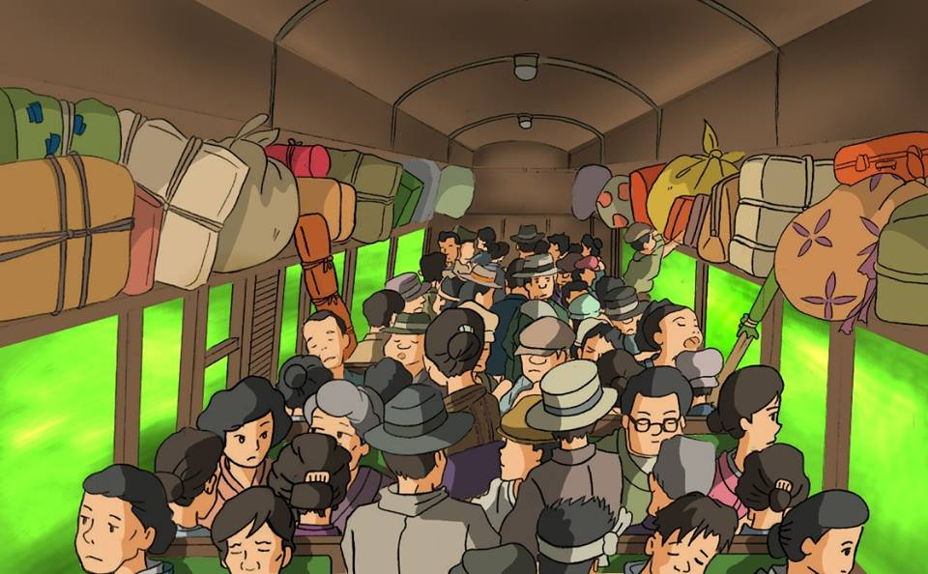
2. Learn to Adjust
There is enough for everybody’s need but not for anybody’s greed.

Slide 14
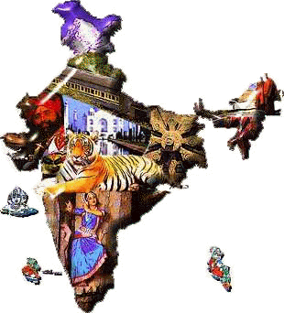
UNITED WE STAND, DIVIDED WE FALL

Slide 15

THANK YOU

Slide 16
SOURCES
Slide 8 PICTURE
http://us.123rf.com/450wm/wavebreakmediamicro/wavebreakmediamicro1509/wavebreakmediamicro150923191/46386315-lonely-student-being-bullied-by-group-of-brutish-classmates-at-the-university.jpg?ver=6

